Slide 1

ED Induction – Common ED Equipment & Procedures
Mr. Robert Ritchie – Emergency Medicine Consultant
Pg Cert (Clin Sup), Dip Mgnt (Leicester), MBBS, FRCS, FFAEM, Member of ACEP
Dr. Niri Pinto – ST3 Emergency Medicine Registrar
MBBS, MRCEM

Slide 2
Common ED Equipment & Procedures
List as many ED equipment on next slide
National Safety, HSE, and Professional Code of practice

Slide 3
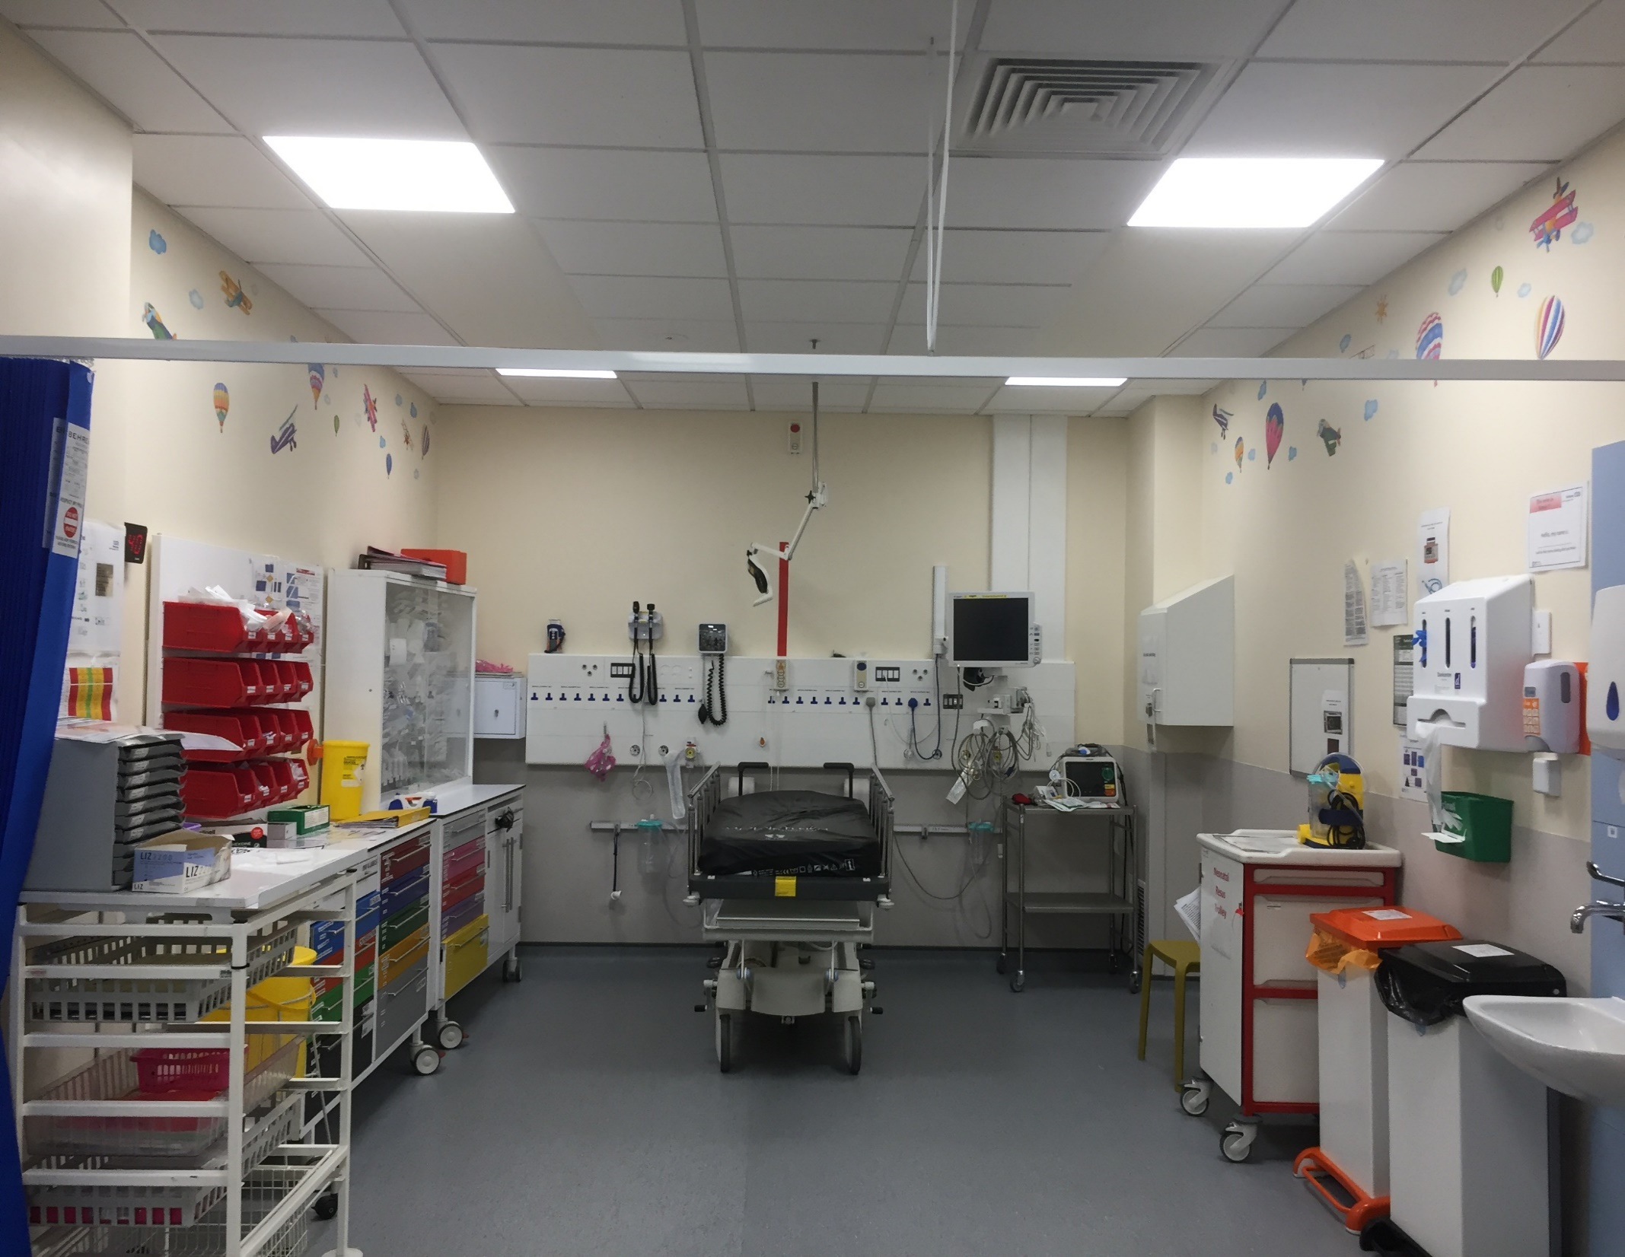

Slide 4
Common ED Equipment & Procedures
(Multi-functional) Cardiac monitor
BP machine
ECG
O-2 & CO-2 monitors, etc
Defibrillator
Thermometer
Wall equipment (ENT, supplies, PPE, etc)
Work-table / Stationery
Light source and bed / trolley
Next room equipment
Urine dip
Urine b-HCG
BM/ Ketone machine
Blood gas machine →ABG/ VBG
Infection control & Janitorial equipment
Anaesthetic Equipment
In Drawers
Phlebotomy and dressing equipment
Medications / Fluids/ Wound care

Slide 5
Common ED Equipment & Procedures
Some Common procedures
ABG
Dressings
Wounds
Types
Tissue Viability Nurse (TVN) service
Sutures
Courses
Web sites
Slit lamp examination
Plastering
C-spine immobilization / Traction
Joint reduction
Haematoma block
FB removal
IFCB / Femoral Block
U/S guided vascular access

Slide 6
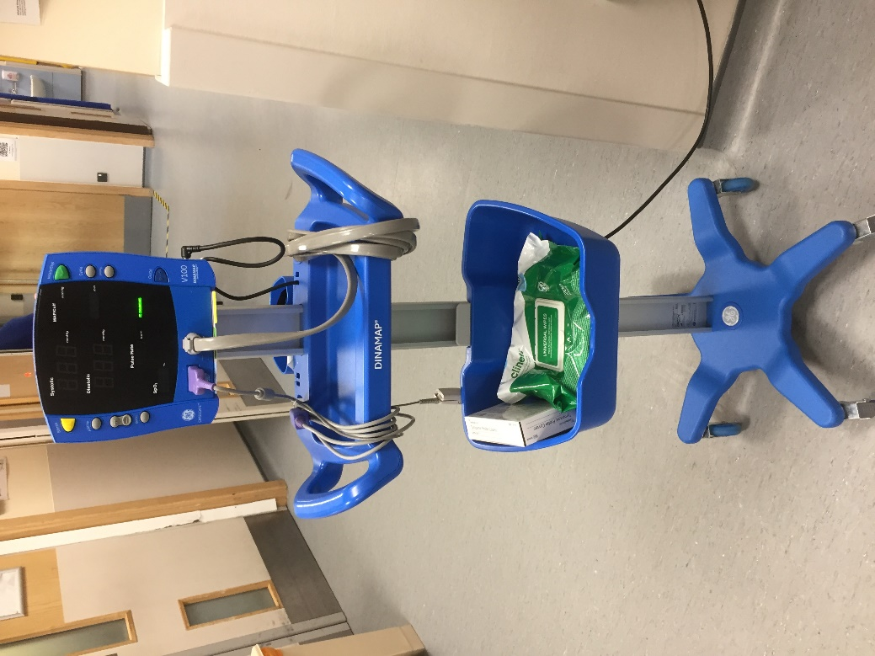
Common ED Equipment & Procedures
Non invasive BP measurement involves the application of pressure cuff
Manual (listening for Kortokoff sounds)
Automatic
Electronic
IR
Thermocouple
“Diagnostic table”
Platysmogram method
BP measuring artefacts
Safe practice

Slide 7
Common ED Equipment & Procedures
Non invasive BP machine – The How to
Appropriately sized cuff to upper arm
Near level of heart
Push start
Cuff inflated above systolic then incrementally deflated
Amplitudes of cuff pressure oscillations measured by a pressure transducer
Amplitudes start to increase to 25-50% of maximum → systolic
Point of maximum oscillation →MAP (most reliable measurement)
Amplitudes decrease by 80% or disappear →diastolic
Notes:
Disadvantages of the oscillometric method
inaccurate: the 95% confidence interval for blood pressure in the normal range is +/- 15mmHg!
can’t be easily calibrated
inaccurate hypovolaemic
cuff small -> high BP
can’t be used in helicopter
Underestimates high blood pressures
Overestimates low blood pressure
the accuracy is even worse if dysrhythmia is present
COMPLICATIONS
arrhythmias
muscle tremors
pain, limb oedema, nerve trauma

Slide 8
Common ED Equipment & Procedures
The ECG machine limitations
Patient, Equipment, and Operator Limitations
Anatomical considerations → Obesity, chest size, location of the heart, lung disease, effusions
Movement during the test → movement artefacts (e.g. Parkinson’s)
Exercise or smoking before the test
Electrolyte imbalances
Some common errors on chest lead placements
Wrong intercostal space
Placing lead on breast
Using different ECG machines on the same patient
Infection control
Hirsute patient
Certain medicines

Slide 9
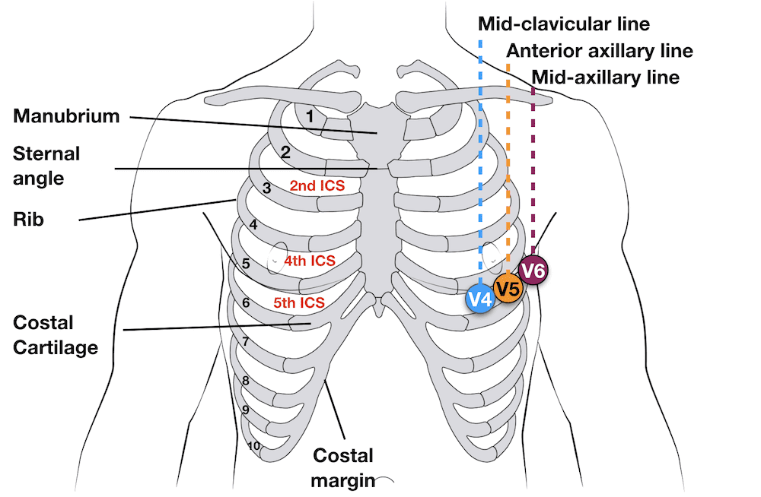
Common ED Equipment & Procedures
The ECG machine
Electrodes attached to the chest and/or limbs record
Small voltage changes as potential difference,
Transposed into a visual tracing

Slide 10
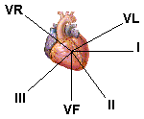
Common ED Equipment & Procedures
Lead Views
Limb leads look from a ‘vertical plane’
I and AVL look from the left side - lateral wall
II, III and AVF look up from the bottom of the heart – inferior wall
AVR looks from the right, but use that to tell you if the leads are on wrongly or Dextrocardia!

Slide 11
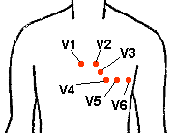
Common ED Equipment & Procedures
Lead Placement
Limb leads – Ride Your Green Bike!
V1- 4th intercostal space to the right of sternum
V2- As above but to the left
V3- Midway between V2 and V4 (do V4 first)
V4- Mid clavicular, 5th intercostal space
V5- Anterior axillary line, horizontal to V4
V6- Mid axillary line, horizontal to V4 and V5
Shave excess hair
use sub-mammary line for female
For limb leads place at wrists and close to ankle
If patient shaking, go for bony areas

Slide 12
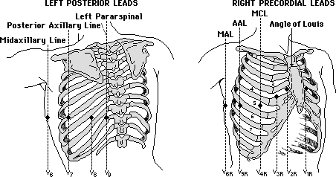
Common ED Equipment & Procedures
Right Sided and Posterior ECGs
Right sided
Inferior MI
Children
Dextrocardia
Could change management of hypotension in post MI patient
Look for ST elevation in rV4
Ensure ECG strip is clearly labelled
Posterior ECG – may not change treatment

Slide 13
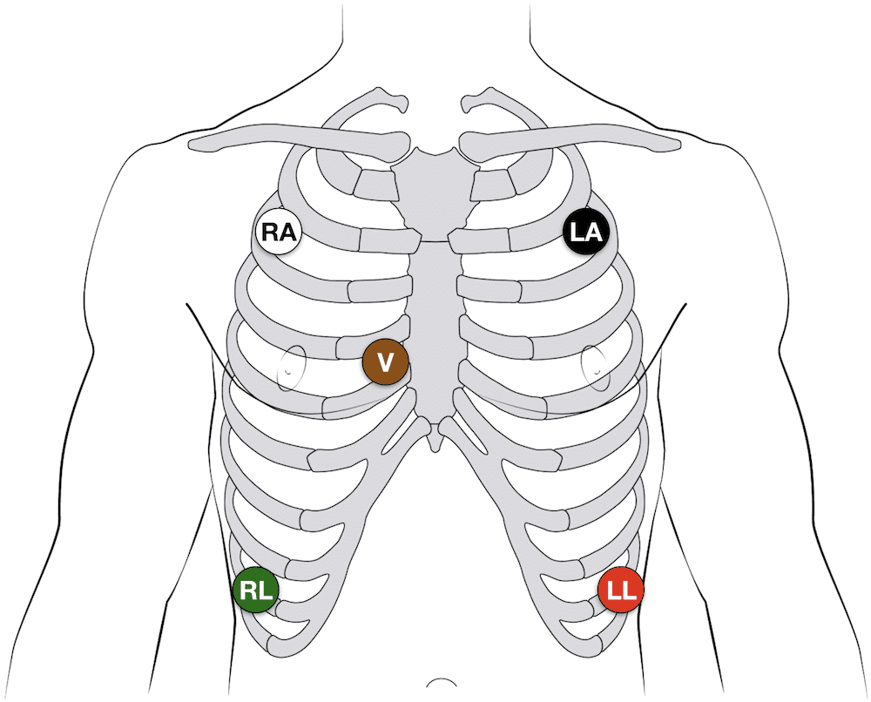
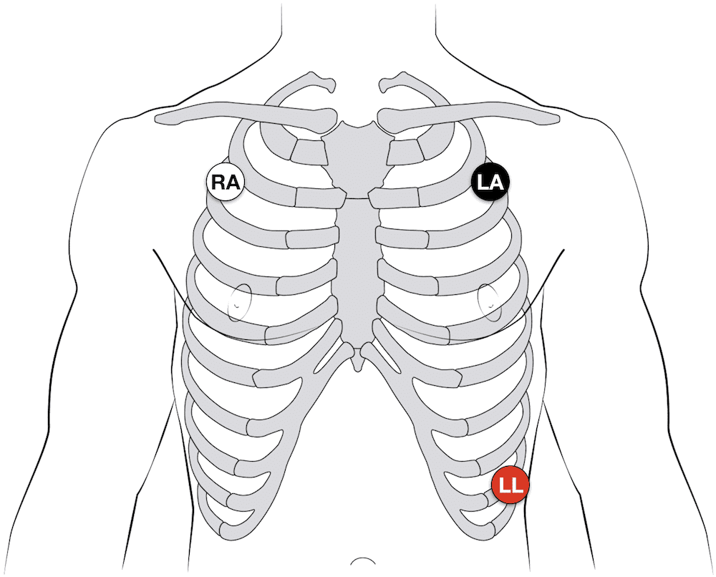
Common ED Equipment & Procedures
5-electrode system
5 electrodes (RA, RL, LA, LL and Chest)
Monitor displays the bipolar leads (I, II and III)
AND a single unipolar lead (depending on position of the brown chest lead (positions V1–6))
3-electrode system
3 electrodes (RA, LA and LL)
Monitor displays the bipolar leads (I, II and III)
Best results – Electrodes equidistant from the heart (rather than the specific limbs)

Slide 14
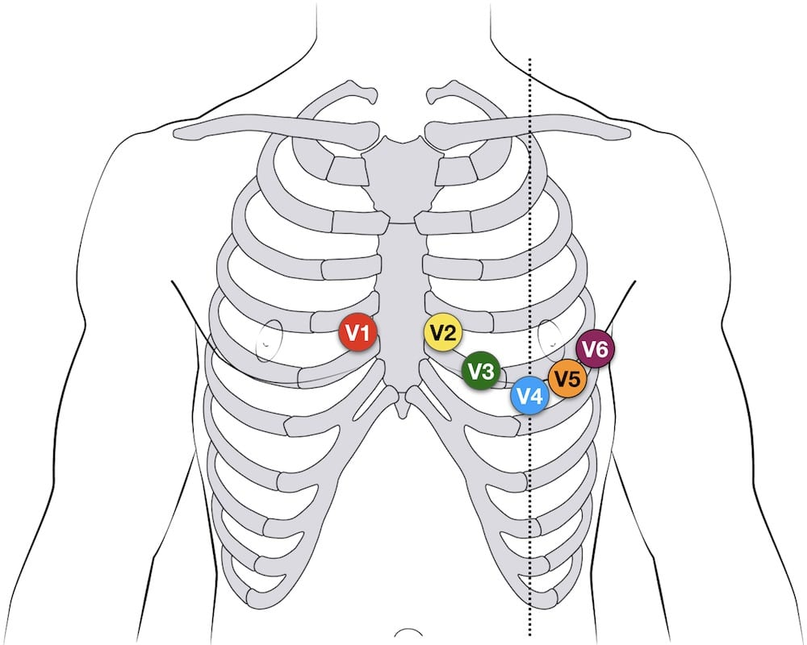
Common ED Equipment & Procedures
12-lead ECG
10 electrodes to produce 12-lead ECG
4 Electrodes on all 4 limbs (RA, LL, LA, RL)
6 Electrodes on precordium (V1–6)
Monitors 12 leads (V1–6), (I, II, III) and (aVR, aVF, aVL)
Identify specific areas of the heart
Inferior (II, III, aVF)
Lateral (I, aVL, V5, V6)
Anterior (V1–4)
12-lead Precordial lead placement
V1: Rt. Parasternal 4th intercostal space V2: Lt. parasternal intercostal
V4: 5th ICS, mid-clavicular line
V3: midway between V2 and V4
V5: 5th ICS, anterior axillary line (same level as V4)
V6: 5th ICS, mid-axillary line (same level as V4)

Slide 15
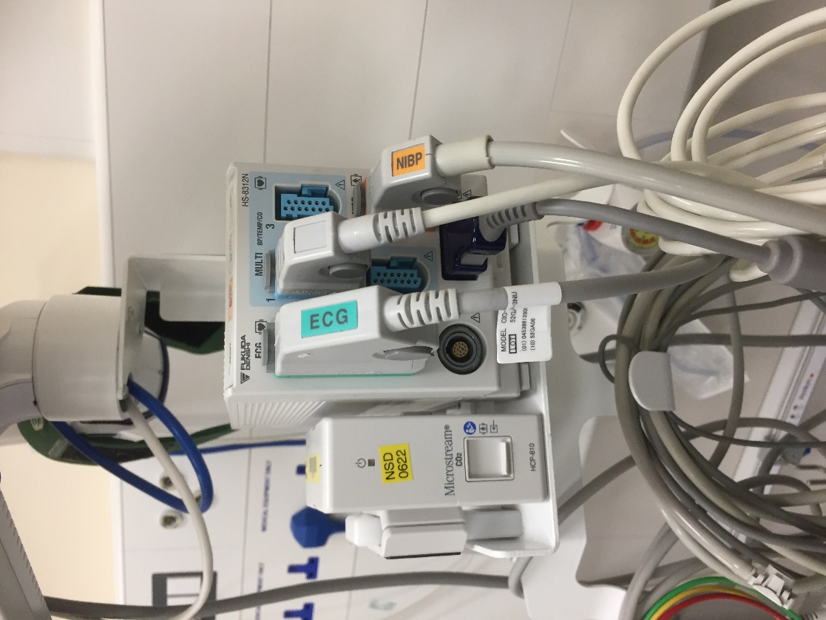
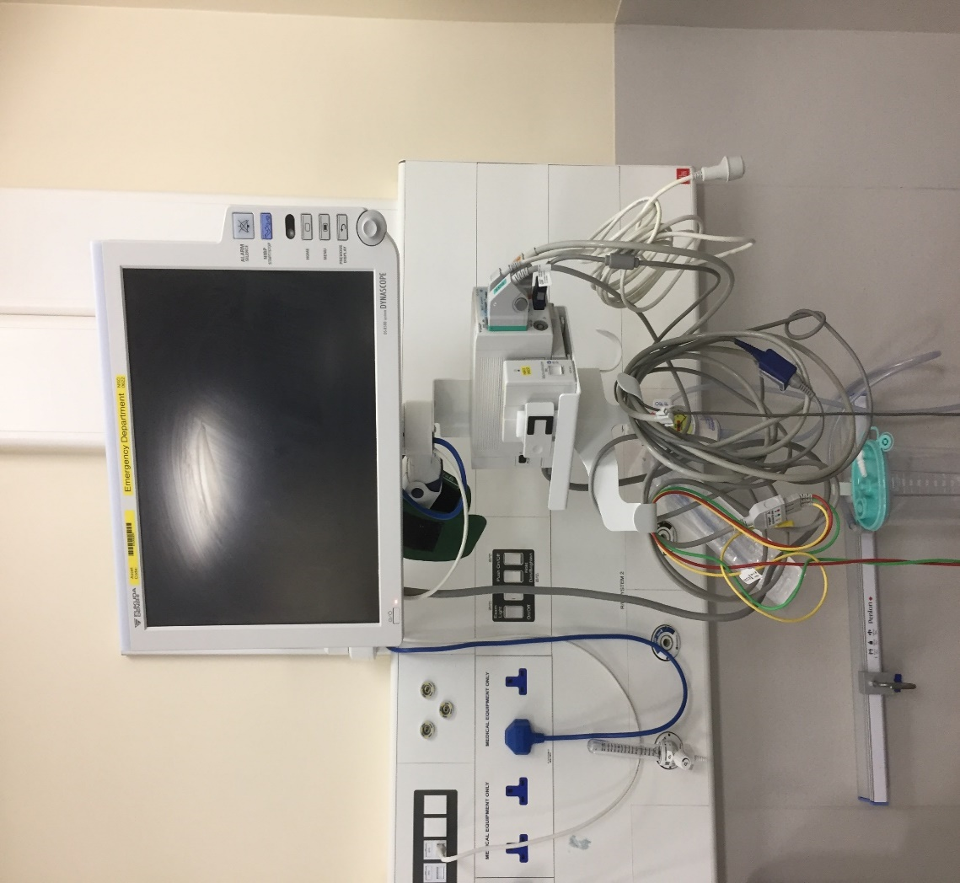
Cardiac Monitor - Show and tell
Common ED Equipment & Procedures

Slide 16
Cardiac Monitor - Show and tell
Common ED Equipment & Procedures
Multi-mode ECG
CO2 Capnograph
SpO2
Non invasive BP
Power
Additional ports e.g. Arterial BP, Temp,

Slide 17
Common ED Equipment & Procedures
Monitor
Remote links uses HL-7 format
O-2 sat
CO-2
Transducer
Temperature thermocouple
Internet / remote links
Multi-mode
3-lead, 5-lead, and 12-lead
Some calibrate to measure Resp Rate
BP
ECG monitor and trace

Slide 18
Common ED Equipment & Procedures
Pulse oximeter
Diodes produce light red + infra-red
Photodetector - on opposite side of probe; detects transmitted light
Signal converter
DC component → tissue + capillary blood + venous blood & non pulsatile arterial blood flow
AC component → pulsatile arterial blood flow
DC component is subtracted
AC component is amplified and averaged over few seconds
Display - Signal is displayed as
Continuous trace
Graph
Table
Notes:
Pulse Oximeter • LITFL • CCC Equipment

Slide 19
Common ED Equipment & Procedures
Pulse oximeter Limitations
SpO2 and SaO2 are not measures of blood or tissue oxygenation
(if [Hb] and cardiac output known, then oxygen delivery (DO2) can be calculated from SaO2)
insensitive to directional changes in PaO2 above 80mmHg
relatively insensitive to perfusion due to gain
reading failure
lag time (around 1 minute)
Artefacts and error (using the wrong probe on the wrong site

Slide 20
Common ED Equipment & Procedures
Pulse oximeter – Some Sources of Error
Motion artefact
Signal to noise ratio (shocked, hypothermia, vasoconstrictors)
Dyshaemoglobinaemias (COHb indistinguishable from HbO2, Met Hb absorbance high -> R = 1.0)
Anaemia
Intravenous dyes
Nail polish
Abnormal pulses (venous waves and ventilation)
Probe position
Low saturations (progressive inaccuracy below 80%)
Non-pulsatile flow (bypass)
Ambient light
Radiofrequency interference (MRI)

Slide 21
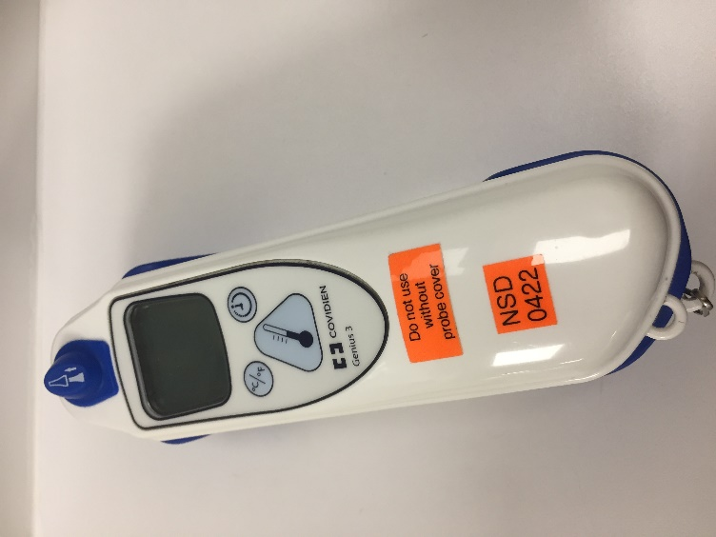
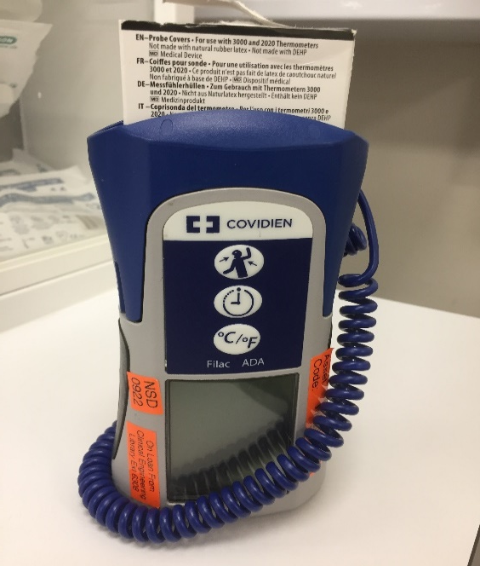
Common ED Equipment & Procedures
Thermometers
Multiple toys and multiple equipment!
Route
Rectal, Oral, Auxiliary, Skin, Vascular, Naso-pharyngeal
Infra-red, Thermocouple, Resistance Temp. Detector (RTD), and Thermistor
Infrared → Portable, easy to use. Affected by ambient environment
Rectal or Bladder → thermocouple device and infrared (via fibre optics)
Errors → operator, locations, mixing types (oral, auxiliary, rectal, infrared on same sheet)
Part of NEWS scoring

Slide 22
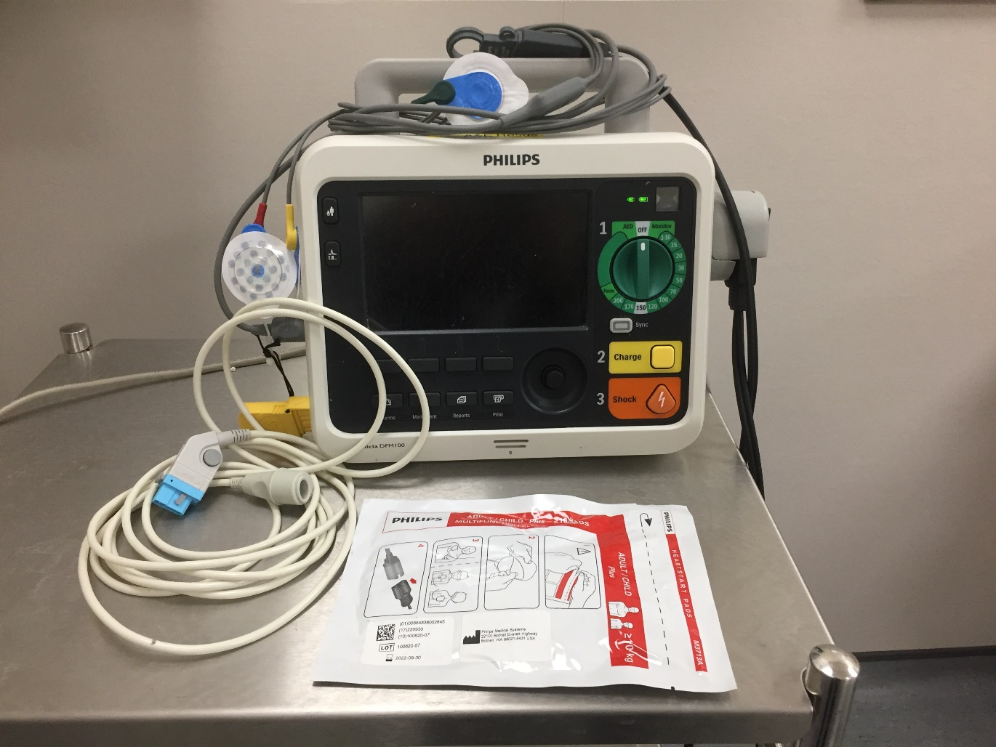
Common ED Equipment & Procedures
Defibrillator
USES → Electrical current across the heart to convert VF/VT to Sinus rhythm
Important equipment in cardiac arrest management
Likelihood of correcting VF/pVT defibrillation is inversely proportional to time
declines at 7-10% per min from onset of VF
Pacemaker function
Synchronised or non-synchronised shocks
Notes:
Defibrillators • LITFL • CCC Equipment

Slide 23
Common ED Equipment & Procedures
Some safety issues
See ALS manual
Sync mode functionality varies between products
Familiarise oneself with machine prior to use
Test how to “dump” unused charge

Slide 24
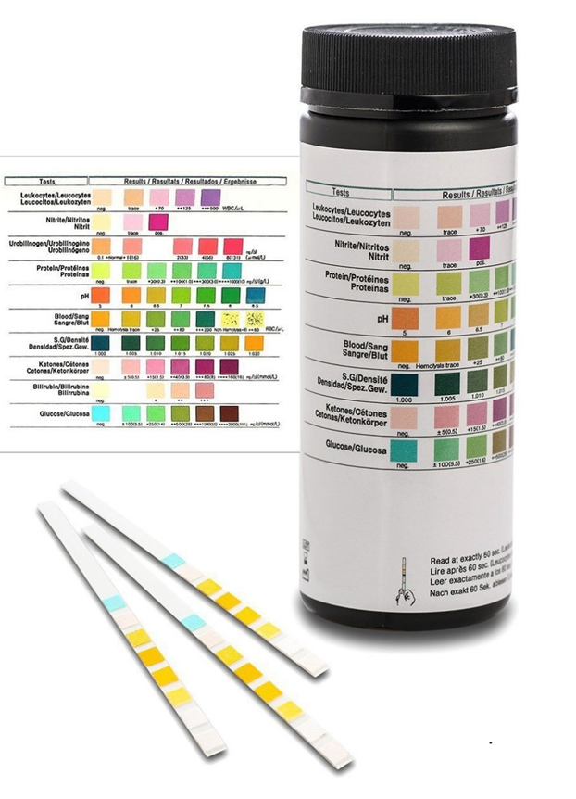
Common ED Equipment & Procedures
Urine Dip
Detection limit set at 90%
Plastic strip with multiple testing agents
Colorimetric (visual and complemented by photometric analysis)
Ketone test: not all ketone bodies are tested.. False positive results
What are ketone bodies?

Slide 25
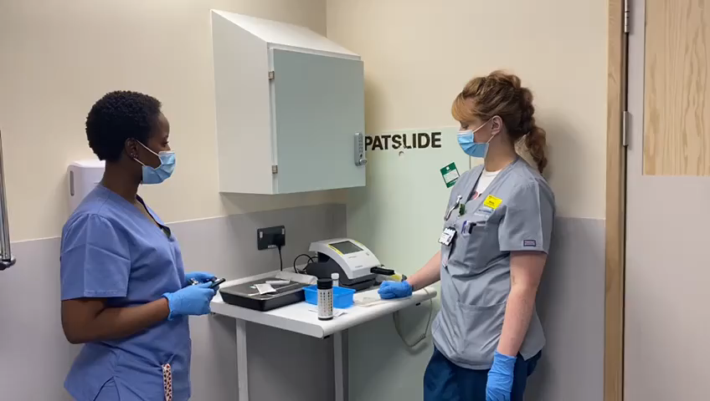
Common ED Equipment & Procedures
Video
Demonstration video of urine dipstick analysis by CSW Kirsty and RN Karin

Slide 26
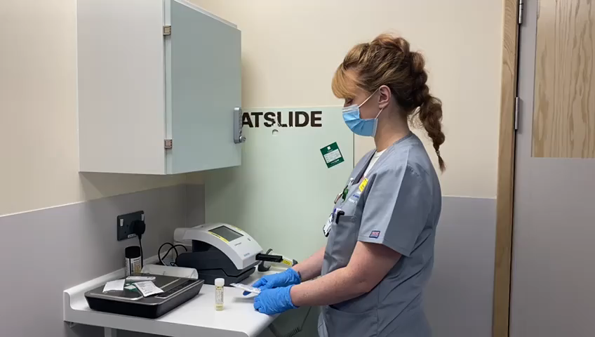
Common ED Equipment & Procedures
Pregnancy b-HCG test
Blood vs. urine
Colorimetric test
Present levels <5: negative
Errors
Biological variation
Trophoblastic pregnancy
Male positive
All men with swollen tests should have a b-HCG test
Why?

Slide 27
Common ED Equipment & Procedures
Video
Demonstration of urine b- HCG test by CSW Kirsty and RN Karin

Slide 28
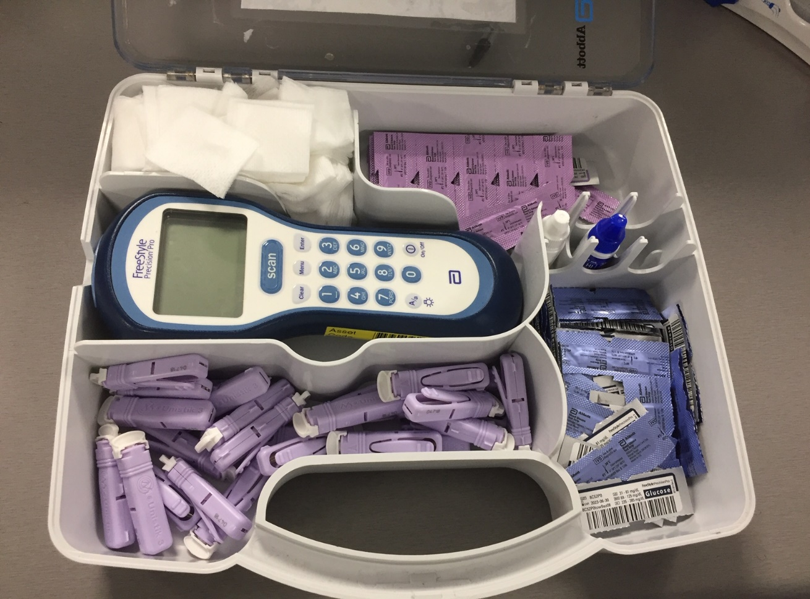
Common ED Equipment & Procedures
BM/ blood glucose machine
BM stands for Boehringer Mannheim, now part of Roche
Some measure plasma glucose whilst others measure whole blood
Change of strips allow blood ketone measurements
Errors with readings
Patient factors
Equipment factors
Operator factors

Slide 29
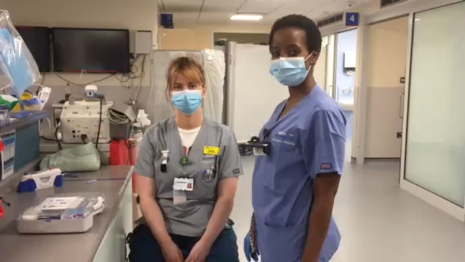
Common ED Equipment & Procedures
Video
Demonstration of BM machine by RN Karin and CSW Kirsty

Slide 30
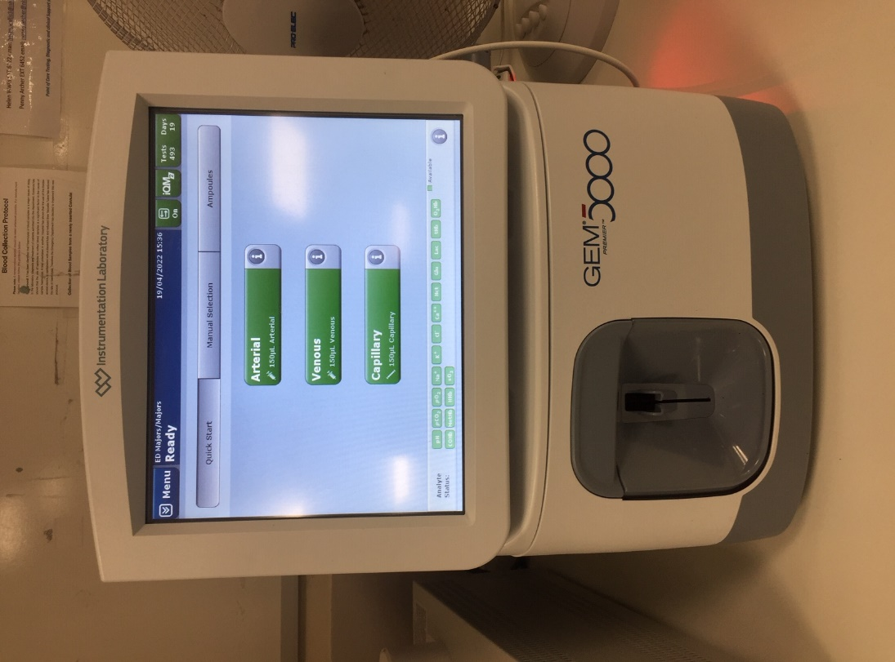
Common ED Equipment & Procedures
Blood gas machine → ABG/VBG
Blood gas/pH analysers:
Electrodes to determine pH, CO-2, O-2,
Chemistry analysers:
Used dry reagent pads
Electrolyte analysers:
Use ion-selective electrode (ISE) to measure ion activity in the solution
Potentiometric analysers:
Used External and Internal reference electrodes
Results could be networked or linked to EPRs

Slide 31
Common ED Equipment & Procedures
References
Non-invasive Blood Pressure • LITFL • CCC Equipment
ECG Lead positioning • LITFL • ECG Library Basics
Pulse Oximeter • LITFL • CCC Equipment
Defibrillators • LITFL • CCC Equipment

Slide 32
Common ED Equipment & Procedures
Acknowledgement
RN Karin and CSW Kirsty gave permission for the creating of this video
Feedback
robert.ritchie4@nhs.net
nirasha.pinto1@nhs.net

Slide 33
Common ED Equipment & Procedures
Summary
Multiple equipment in ED
Seek advice / support from colleagues if unsure
Consider Safety to patient, oneself, and colleagues when using equipment

Slide 34
Common ED Equipment & Procedures
Questions?
Feedback
robert.ritchie4@nhs.net
nirasha.pinto1@nhs.net

